Slide 1
Ethernet Routing Overview

Slide 2
Agenda
Ethernet history
Frame types
Ethernet transmission
Addressing
Bridging/Switching
Bridge protocols
Switch Functions
Carrier Ethernet

Slide 3
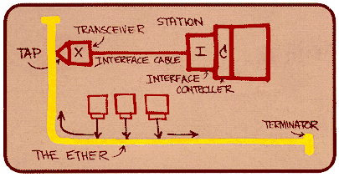
History
Invented by Robert Metcalfe and David Boggs in ~1972
10Mbps 1985
100Mbps 1995 (802.3u)
1Gbps 1998 (802.3z)
10Gbps 2002 (802.3ae)
40/100Gbps 2010 (802.3ba)

Slide 4
Standardization
IEEE 802 LAN/MAN Standards Committee
http://www.ieee802.org
Jointly published as ISO standards
Application
Application
802.2 Logical Link Control (LLC)
Presentation
Session
Data link
layer
Transport
802.1 Mgt.
802.1 MAC Bridging
Network
Data Link
802.3
802.4
802.5
802.6
802.9
802.11
802.12
Physical
Physical
layer
OSI model

Slide 5
Physical Layer
Responsible for encoding the payload and transmission on the physical media
Preamble
Start frame delimiter
RS (Reconciliation Sublayer)
PCS – Physical Coding Sublayer
Codes data before Tx
Decodes data after Rx
Collision, carrier sense
PMA (Physical Medium Attachment)
Tx, Rx, Reset, Clock recovery, Link integrity, Align
PMD (Physical Medium Dependent)
Digital to Physical conversion

Slide 6
Media Access Control Layer
Media Access Control (MAC)
Framing
Addressing
Error detection
Collision avoidance (Half duplex)
Collision handling (Half duplex)
MAC Control
Pause frames

Slide 7
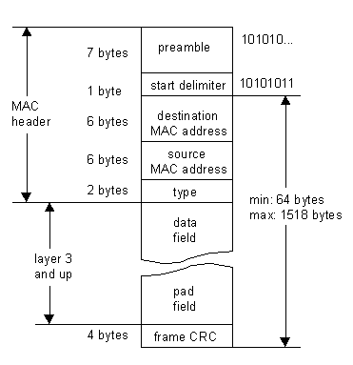
Ethernet Frame Format

Slide 8
MAC Addresses
Address structure
OUI (vendor) part
Device part
Ethernet addressing
Unicast
Multicast (X1-XX-XX-XX-XX-XX)
Broadcast (FF-FF-FF-FF-FF-FF)
Locally/Globally administered
Multicast/Broadcast Source addresses not allowed

Slide 9
Frame Types
Ethernet II
EtherType: 1536 – 64K
LLC (Logical Link Control protocol)
EtherType: 0-1535
LLC/SNAP (Subnetwork Access Protocol)

Slide 10
Ethernet Frame transmission
Min Frame 64 bytes
64/(64+20)
~76,2% utilization
= 7,62Gbps (10G)
Max frame 1518 bytes
1518/(1518+20)
~98,7% utilization
=9.87Gbps (10G)
9600 byte jumbo frame now widely supported
Again to decrease overhead

Slide 11
Repeaters
Forwarding based on Layer1 info
Amplification of electrical signal
Extending the diameter of the LAN and the number of attached stations
Only legacy equipment (10/100Mbps)

Slide 12
Bridging
Forwarding based on Layer2 info
Division of collision and access domains

Slide 13
Bridging (cont’d)
Bridges can learn MAC addresses on segments
Interconnecting different LAN technologies
Ethernet, Token-ring, FDDI etc.
Bridging behavior
Forward all multicast and broadcast frames
Forward unknown DMAC addresses
Don’t forward ’local’ frames (when SMAC and DMAC is on the same Ethernet segment)
Don’t forward frames with bad checksum

Slide 14
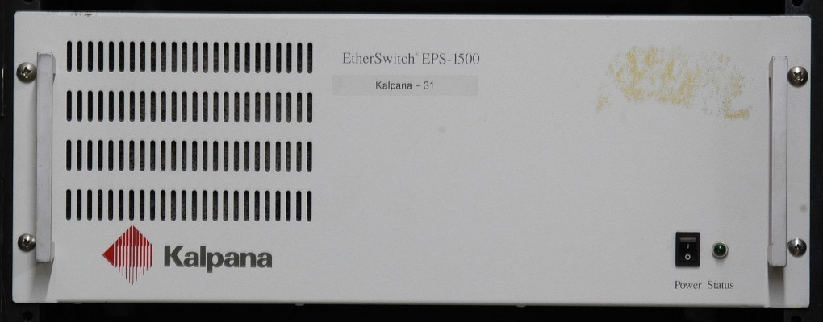
Switching
Defined as Multiport bridging by Kalpana 1990
Multiple access domains, higher network bandwidth utilization
Less ’shared’ network traffic to be snooped
Switching Functionality
Forward based on Destination MAC Address (DA)
Learn stations positions in network based on Source MAC Addresses (SA) - “Backward Learning”
Age of old address entries based on activity timer
© Retro-Computing Society of Rhode Island

Slide 15
Switching (cont’d)
Flood frames with
Broadcast DA
Unknown multicast DA
Unknown unicast DA
Forward to known port(s):
Known multicast DA to multiple ports
Known unicast DA to one port
Never:
Send frame back to source port

Slide 16
Bridge Protocol Datagram Units (BPDU)
Group of link-local messages
MAC address range 01-80-C2-00-00-00 to -0F
MAC Control
Pause frames 01:80:C2:00:00:01
Reserved Ethertype 0x8808
Used for lossless transmission (congestion/backoff signaling)
Slow Protocols
Link Aggregation Control Protocol (LACP)
Rapid & Multiple Spanning Tree Protocol (RSTP / MSTP)
Operations, Administration, and Maintenance (OAM)
MAC control frames must never be forwarded to another Ethernet segment
i.e. terminated in the switch

Slide 17
Spanning Tree Protocol (STP)
Used to avoid loops in bridged LANs
LLC encapsulation
Reserved DSAP
Reserved multicast address
01:80:C2:00:00:00
Individual ports can be in one of these states
Listening,Learning, Forwarding or Blocking
Rapid Spanning Tree Protocol (RSTP, 802.1w)
Enhanced STP with much faster convergence
Multiple Spanning Tree Protocol (MSTP, 802.1s)
“RSTP per VLAN”
Same port states as STP
Up to 64+1 ‘network trees’.
Mapping of VLANs to trees

Slide 18
VLAN
Virtual LAN IEEE802.1Q
Separation of broadcast domains
Some security benefits
Insert new VLAN header
4 bytes after MAC adresses and in front of current Etype field
Ethertype 0x8100
Changes to Ethernet frame size

Slide 19
General Switch Function
MAC – validates frame
Classification – CoS selection
Address Engine – destination computation
MAC – transmit frame

Slide 20
Reception – MAC
Validates the incoming frame
Detects coding, protocol and Frame Check Sequence errors
Collects statistics information
Management and monitoring (SNMP, RMON, SMON)

Slide 21
Classification
Parses frame and assigns Class of Service (CoS) level, based on
Layer 1 (Port number, speed)
Layer 2 (SA, DA, VLAN, EtherType, MPLS label)
Layer 3 (Protocol, IP addresses, DSCP)
Layer 4 (TCP/UDP Port numbers)
CoS is used to select the queue in the Queue System
Main differentiators:
Which fields can be used to assign CoS
Number of Classes
Programmability, flexibility
State-machine vs ACL (t-CAM)

Slide 22
Queue System
Distributed or shared memory subsystems
Sharing between ingress/egress & ports
A fully shared memory system gives the best (theoretical) performance
Main differentiators:
Amount of available memory (granularity, efficiency)
# Priority queues (Classes of Service)
Quality of Service
Scheduling strategy
Drop strategy
Queue overflow handling

Slide 23
QoS – Scheduling Strategies
Strict Priority (SP)
Always serve the highest priority queue first. Go on to lower priority if no data in the current queue.
Round Robin (RR)
Always ask the next queue in the sequence
Go on until finding data in a queue
Weighted Round Robin (WRR)
As RR, but queues are allowed to send a number of packets corresponding to their individual weights.
Weighted Fair Queuing(WFQ)
Give low bandwidth traffic high priority
Monitor incoming flows
Prepare scheduling

Slide 24
Queue System – Overflow Handling
Tail-drop
Drop incoming packets
Head-drop
Drop the oldest packet (conceptually, ”shift packets”)
May help TCP discover packet discard earlier
Intentional drop mechanisms
Drop packets on basis of queue level, packet priority, etc., before or after the queue

Slide 25
Drop Strategies
Random Early Detection (RED)
Randomly drops packets in periods of medium load ⇒ TCP decreases data rate rather than backing off
Weighted Random Early Detection (WRED)
As RED, but drops packets selectively based on some marking principle, e.g. IP DSCP
Packet discard probability
1
0
Empty
Treshold
Full
Output queue level
Notes:
http://www.qosforum.com/docs/glossary/glossary.htm:
Random Early Detection (RED):
A congestion-avoidance algorithm developed in the early 1990s built on the base-level TCP behavior of automatically slowing transmissions when packet loss is detected. RED tries to anticipate congestion by monitoring a queue on a router When the specified threshold is reached, it randomly discards packets. This is an implicit signal that the originating applications should slow their transmissions before congestion becomes severe. Unlike CBQ, WFQ, SFQ, RED does not require flow-state in routers.
Also a process of intelligent cell discard that occurs within an ATM switch when its buffer capacity is exceeded. RED discards cells in a round-robin fashion among affected connections.

Slide 26
Scheduling Strategies
Strict Priority (SP)
Always serve the highest priority queue first. Go on to lower priority if no data in the current queue.
0
0
0
0
0
0
0
0
0
0
0
1
1
1
1
1
1
1
1
1
1
1
2
2
2
2
2
2
2
2
2
2
2
3
3
3
3
3
3
3
3
3
3
3

Slide 27
Scheduling Strategies (2)
Round Robin (RR)
Always ask the next queue in the sequence
Go on until finding data in a queue
0
0
0
0
0
0
0
0
0
0
0
1
1
1
1
1
1
1
1
1
1
1
2
2
2
2
2
2
2
2
2
2
2
3
3
3
3
3
3
3
3
3
3
3

Slide 28
Scheduling Strategies (3)
Weighted Round Robin (WRR)
As RR, but queues are allowed to send a number of packets corresponding to their individual weights.
WRR Variants
Weight unit is bytes rather than packets
Queue with higher weight is served more frequently
Weight
0
3
0
0
0
0
0
0
0
0
0
0
1
1
1
1
1
1
1
1
1
1
1
1
2
1
2
2
2
2
2
2
2
2
2
2
3
1
3
3
3
3
3
3
3
3
3
3

Slide 29
Scheduling Strategies (4)
Weighted Fair Queuing(WFQ)
Give low bandwidth traffic high priority
Monitor incoming flows
Bandwidth of flows or groups of flows
Prepare scheduling
High and low priority packets in separate queues
Notes:
http://www.qosforum.com/docs/glossary/glossary.htm:
Weighted Fair Queuing (WFQ):
Per-flow packet scheduling in network elements that automatically categorizes traffic flows into high and low priority, based on volume of packets seen by a router or switch. Low-bandwidth traffic has effective priority over high-bandwidth traffic, and high-bandwidth traffic shares the transmission medium proportionally according to assigned weights. Like class-based queuing (CBQ), WFQ is designed to prevent any one traffic type from entirely eclipsing another. By default, WFQ favors lower-volume traffic flows over higher-volume ones (for example, a routine e-mail over a large FTP download).
(unknown source)
Some source indicates this principle…
”Tag any packet with a preferred transmission time.
The packet with the lowest tag value is sent first.”

Slide 30
Drop Strategies – WRED
Weighted Random Early Detection (WRED)
As RED, but drops packets selectively based on some marking principle, e.g. IP precedence.
Packet discard probability
1
Low precedence packets are discarded using RED1
High precedence packets are discarded using RED2
0
Empty
Treshold 1
Treshold 2
Full
Output queue level
Notes:
http://www.qosforum.com/docs/glossary/glossary.htm:
Weighted Random Early Detection (WRED):
Combines IP precedence and Random Early Detection (RED) capabilities to provide differentiated performance characteristics for different classes of service. Packets with a higher IP precedence are less likely to be dropped than those with lower precedence

Slide 31
Drop Strategies – summary
Random Early Detection is an extension to a scheduler, NOT a scheduling strategy in itself
RED works on top of a scheduling mechanism to assist TCP in adapting to network congestion

Slide 32
Addressing Engine – Address Table
Content Addressable Memory, using (VID, MAC) as key
Key is 60 bit → hashing used to avoid using HW CAMs
Learning based on (VID, Source Address)
Main differentiators:
Capacity (8K – 64K entries)
Hash depth (2 – 8)
Learning speed (wire-speed vs not wire-speed)

Slide 33
Addressing Engine/Analyzer
Looks up Addresses, and computes destination port-set based on
Destination Address (Port Group ID)
Source port (masking, for avoiding loops)
VLAN Spanning Tree state (learn/forward)
VLAN Id
Mirroring and CPU copy/redirect operations
Port Aggregation
Computes port bitmask:
DEST = (pgid AND src AND stp AND vlan OR mirror OR cpid) AND aggr

Slide 34
Addressing Engine - Example
DEST = (pgid & src & stp & vlan | mirror | cpid) & aggr
Destination: ports 6 & 7
Source: port 0
STP: all ports active
VLAN: ports 2 & 1 not member
Mirroring: port 3
Copy to CPU signaled
Aggregation: ports 7 & 6
Send frame to:
CPU queues (CPU copy)
Port 6 (ordinary forward)
Port 3 (mirror copy)

Slide 35
Transmission – MAC
Transmits the outgoing frame
Detects collision and retries transmission, formats frame according to the standard and generates Frame Check Sequence
Performs updates to the frame
VLAN insertion, User_priority / DSCP rewrite
Collects statistics information
Management and monitoring (SNMP, RMON, SMON)

Slide 36
Carrier Ethernet - Challenges
Ethernet originally designed for data communication within a LAN
Providing high bandwidth at low cost
“Best effort” technology: If dropping data, just retransmit
Why use Ethernet in telecom and other time sensitive applications?
It’s dirt cheap! (compared to other legacy technologies)
What’s the challenge?
Replacing deterministic technologies with “best effort”
Delivery of telecom services, spanning multiple networks
Requirement for delivery guarantee, beyond what standard Ethernet is capable off
A new set of attributes on top of Standard Ethernet is required
iiiiiiii

Slide 37
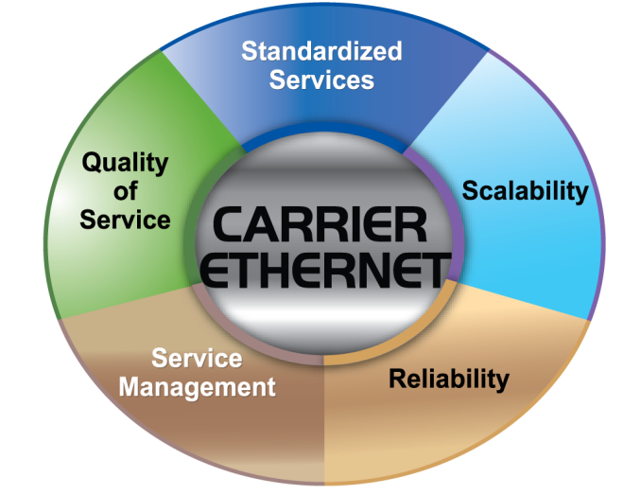
Carrier Ethernet - Definition
Definition of Carrier Ethernet (by MEF):
“A ubiquitous, standardized, carrier class Service and Network defined by 5 attributes, that distinguish it from familiar LAN based Ethernet

Slide 38


Carrier Ethernet – Definition, cont’d
Standardized services
Service: A common way of handling a flow of frames
Service concept defined in MEF 6.1 (Service types) and MEF 10.1 (Service properties)
Services provided to multiple customers instead of only one customer (LAN)
Services provided on multiple networks instead of on one (LAN) network
CPE
LAN B
CPE
LAN B
LAN A
LAN B
CPE
CPE
CPE
LAN A
LAN A
LAN C
LAN C
E-Line
E-Tree
E-LAN

Slide 39
Carrier Ethernet – Definition, cont’d
Scalability
Need to be able to scale to millions of nodes as opposed to a few hundreds or thousands
Large number of services to be supported as opposed to a few services
Use of double VLAN tagging where an outer Service tag (S tag) is used for carrying the Customer tagged (C tagged) traffic.

Slide 40
Carrier Ethernet – Definition, cont’d
Reliability
Link failure protection switching within 50ms
Fault recovery as fast as possible to ensure uptime according to Service License Agreement (SLA). “Five nines” (99.999%) uptime equals total max downtime of only 5.26 min/year!
Services provided on multiple networks instead of on one (local) network
Active path
1+1: Both links active
RPL Owner
1:1: One active, one backup
Backup path
RPL (Ring Protection Link)
G.8031
Line protection switching
G.8032
Ring protection switching

Slide 41
Carrier Ethernet – Definition, cont’d
Service Management
Must be able to quickly provision bandwidth for specific service across the network
Must be able to monitor and detect faults across multiple networks and on equipment from multiple vendors
Features supporting service management include
OAM (Operations, Administration, and Maintenance)
Link OAM (link discovery, link monitoring, remote failure indication, loopback)
ITU-T Y.1731 Performance Monitoring and Fault Management
SAT (Service Activation Test) – ITU.T Y.1564 - Ensuring bandwidth profile parameters:
CIR and EIR (Committed and Excess/Peak Information Rate)
CBS and EBS (Committed and Excess/peak Burst Size)
RFC2544 (measuring e.g. throughput, latency, and frame loss)

Slide 42
Carrier Ethernet – Definition, cont’d
Quality of Service (QoS)
QoS required to support multiple different services (time sensitive applications, e.g. voice and video as well as standard data services)
QoS required to treat traffic from multiple customers traffic in accordance with each individual SLA
Bandwidth profile parameters (CIR/EIR, CBS/EBS) are used in “color coding” the service frames:
Green: Frame is CIR/CBS compliant and must be forwarded in the network
Yellow: Frame is not CIR/CBS compliant but EIR/EBS compliant and might be forwarded in the.
Red: Frame neither CIR/CBS nor EIR/EBS compliant´. Frame must be dropped.

Slide 43
Carrier Ethernet – Timing/synchronization
To ensure the reliability and quality as well as enabling the service management, synchronization of across the network is also needed
Timing synchronization across the network using PTP – Precision Timing Protocol – IEEE1588 (-2008 aka PTPv2):
Agreement throughout the network of both clock phase and frequency
Clock phase and frequency communicated using standard Ethernet frames
Minimizes latency and delay variations across the network
Provides accuracy in the nanosecond range
Important also within Industrial Ethernet (Indstrial Automation, Time-Sensitive Networking/TSN), another big focus area of Microsemi ENT BU

Slide 44
Thank You
Nov 2017

Slide 45
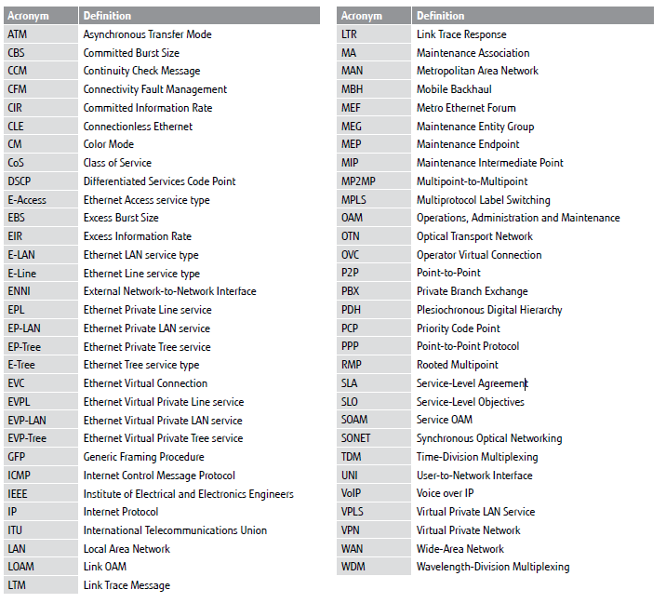
Carrier Ethernet Acronym List
Acronym list © Copyright 2010 Fujitsu Network Communications

